Slide 1
CS 7290 Causal Machine Learning Project
Presenter: Poojan Thakkar

Slide 2
Agenda
About the Data
Exploration of the Data and insights gained
Creating the causal model
Identification
Estimation
Refutation
Questions

Slide 3
Motivation
Existing datasets and census contain numerous variables
The dataset in question being old, is limited in dimensionality
Wanted to see the effect of having limited/unimportant features on outcome
Entire process ultimately may be used as a counterfactual in terms of observed effect of having additional indicators

Slide 4
About the Dataset 1
A 1980 census extract, also used in Angrist and Krueger(1991)
Number of observations: 329,509 observations
Variables:
log weekly wage
quarter of birth (1-4)
year of birth (30-39)
place of birth (1980 census state codes)
education (highest grade completed)

Slide 5
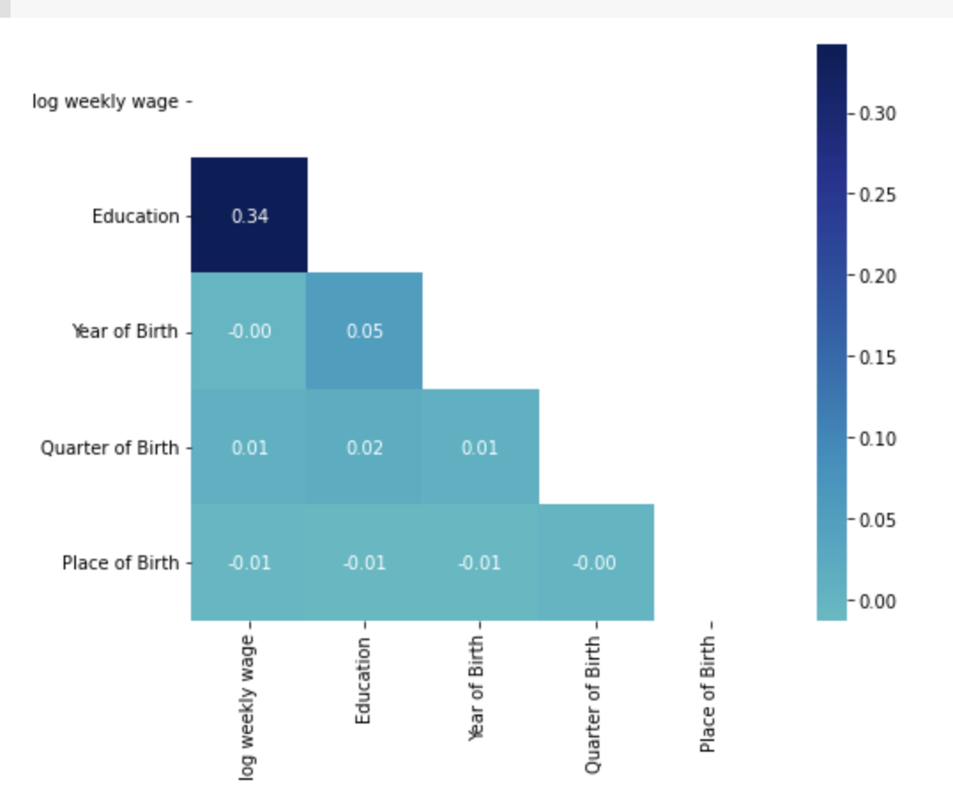
Exploratory Analysis of the Data and Insights gained
Correlational Analysis:

Slide 6
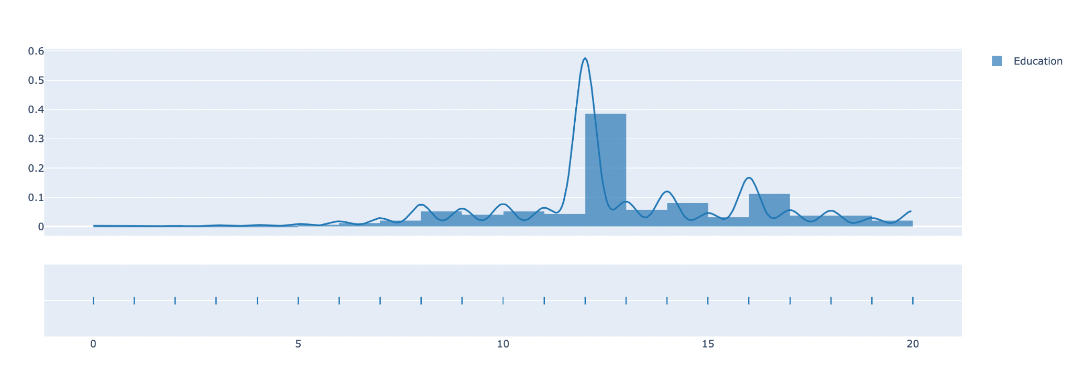
Exploratory Analysis of the Data and Insights gained
Distribution of Data:
Notes:
As seen in the figure, about 60% of the survey respondents said 12th grade was the highest level of achieved education

Slide 7
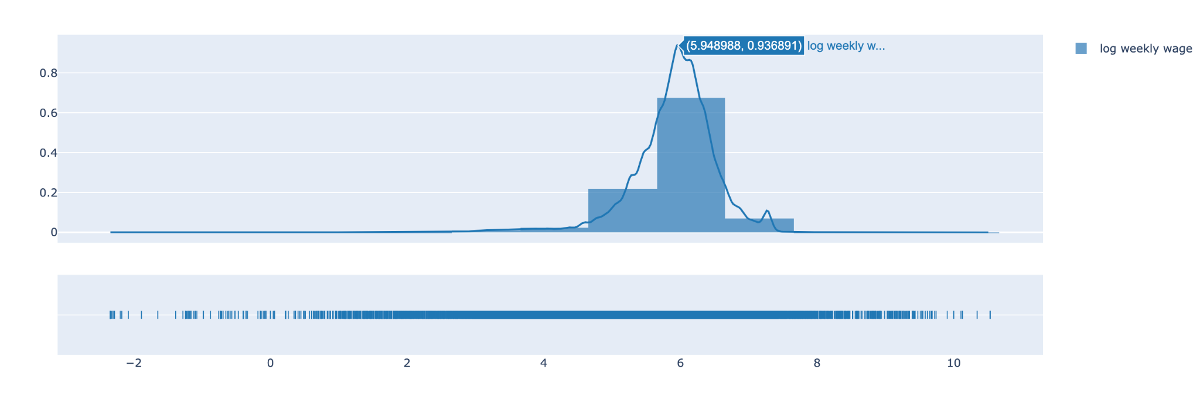
Exploratory Analysis of the Data and Insights gained
Distribution of Data:
Notes:
A similar pattern observed, where a large majority of population earns a log weekly wage in a given range

Slide 8
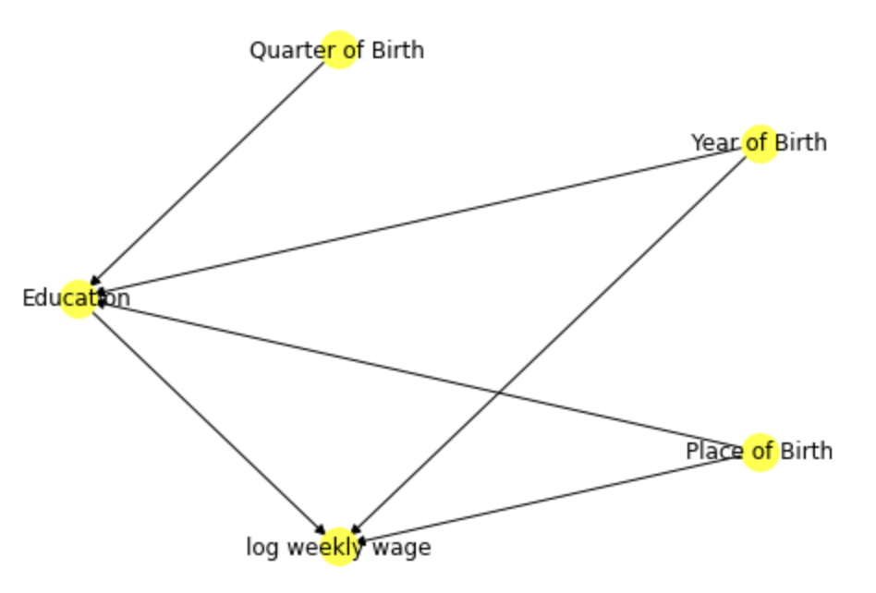
Creating the Causal Model
Confounding Variables: Year of Birth, Place of Birth
Instrumental Variables: Quarter of Birth
Treatment variable: Education
Outcome variable: log weekly wage
Notes:
As seen in the correlational analysis, Education and log weekly wage were the two variables that displayed a degree of correlation, hence for this setup, we treat YoB and Pob as confounding variables

Slide 9
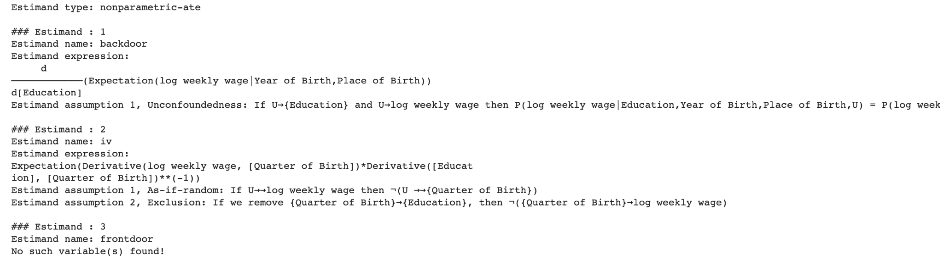
Identify the causal effect and target estimands

Slide 10
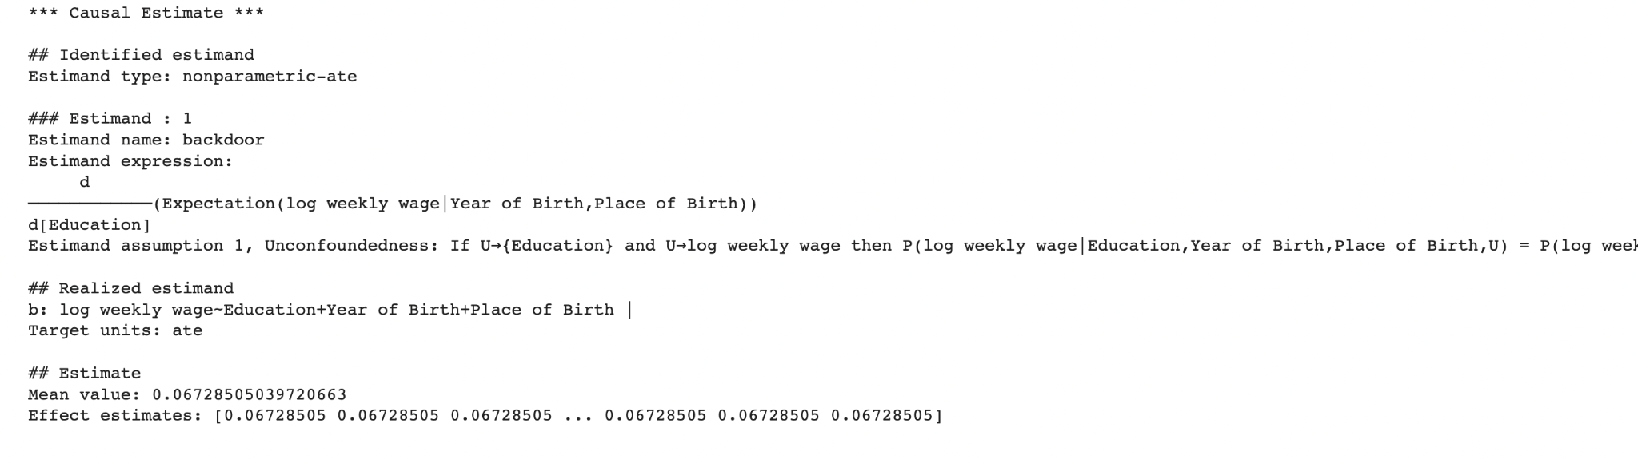
Estimation

Slide 11
Refutation
Refuter method name | 5 simulation results | 10 simulation results
Placebo treatment refuter | New effect : -8.127046919091176e-05 p value:0.3085375387259869 | New effect: 4.941874312697637e-05 p value: 0.3806371587593064
Random common cause | New effect: 0.06741759387925192 p value: 8.083076216829843e-14 | New effect: 0.06742075100105521 p value: 3.0013126693561697e-19
Data subset refuter | New effect: 0.0672258477130735 p value:0.3748825883254183 | New effect: 0.06753301668681726 p value: 0.06529203781973415

Slide 12
About the Dataset 2
Wage data from UCI’s ML repository, containing variables such as
year
age
sex
maritl
race
education
region
jobclass
health
health_ins
logwage
wage

Slide 13
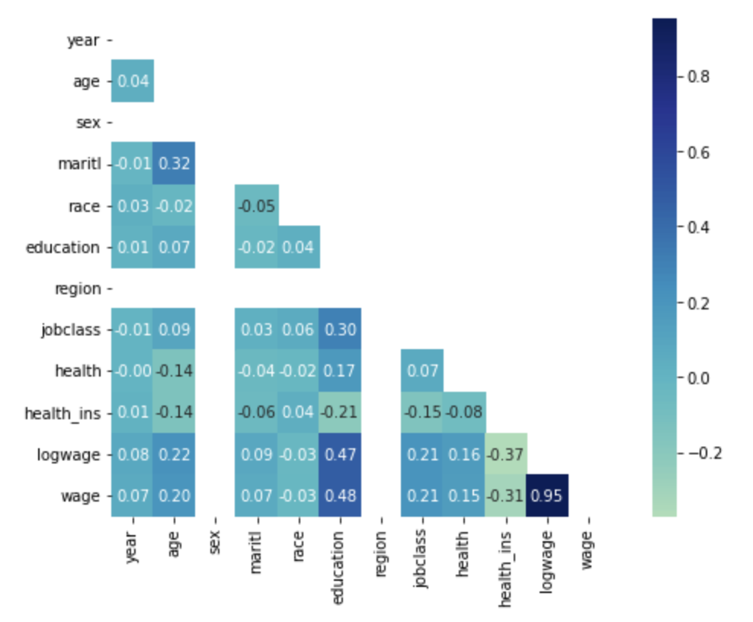
Exploratory Data Analysis and Insights gained

Slide 14
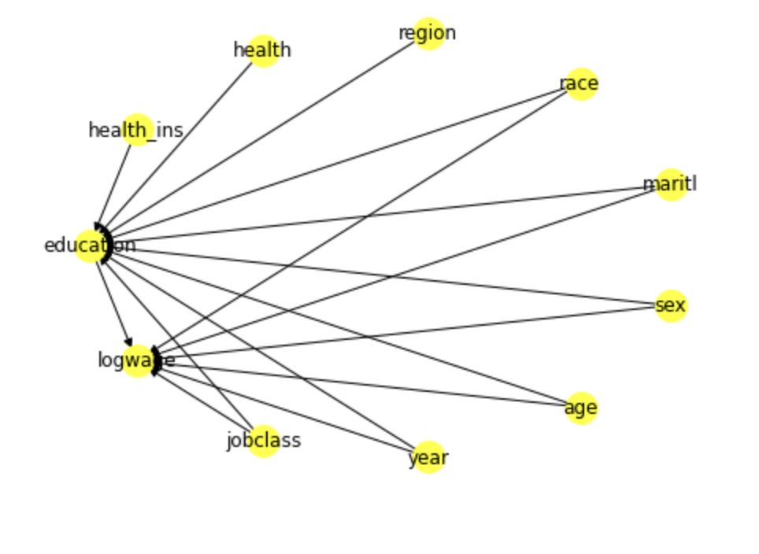
Creating the Causal Model
Confounding Variables: jobclass,year,age,sex,maritl,race
Instrumental Variables: region,health,health_ins
Treatment variable: Education
Outcome variable: log weekly wage

Slide 15
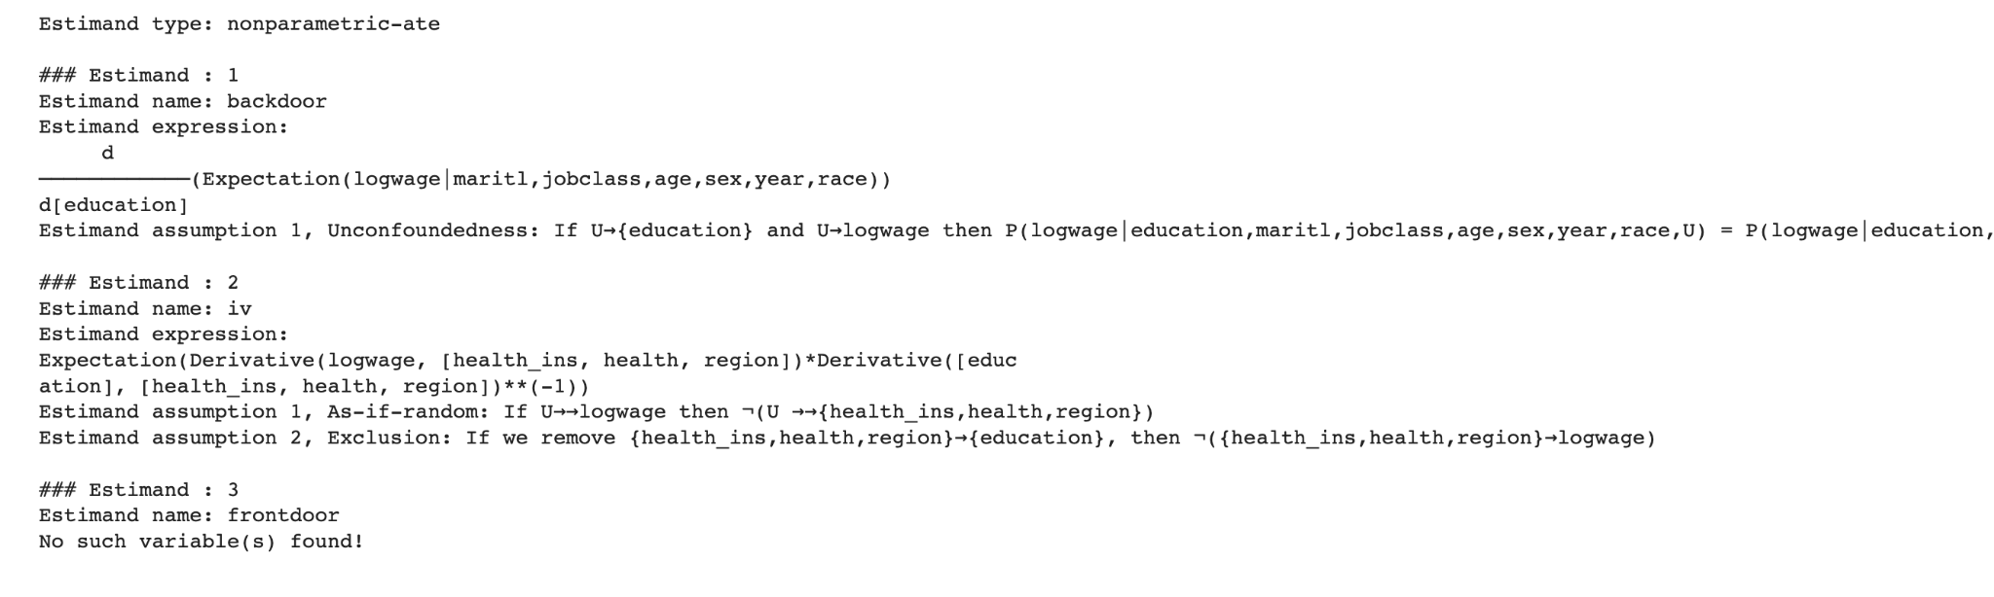
Identify the causal effect and target estimands

Slide 16
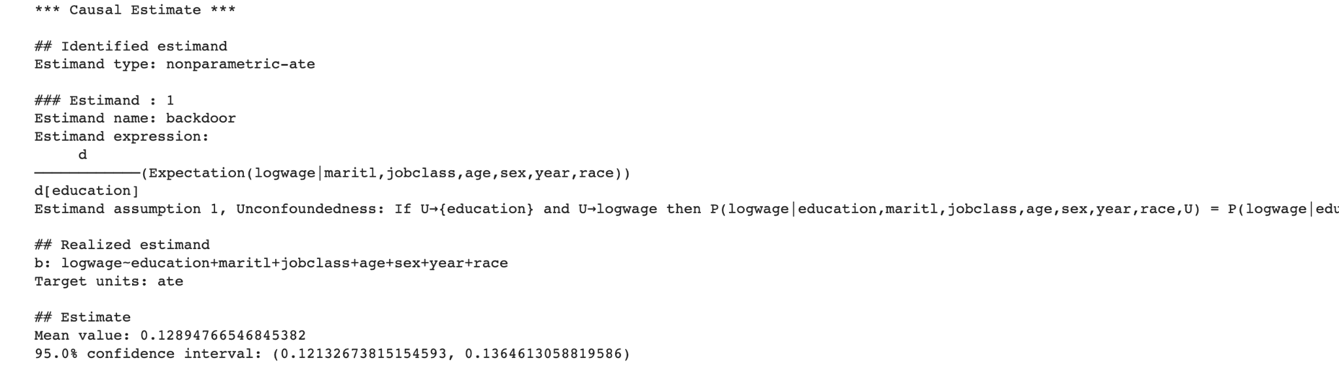
Estimatation

Slide 17
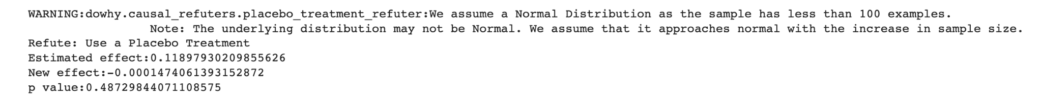
Refutation

Slide 18
Conclusion
As seen from Dataset 1, one variable showing causal effects on outcome may not tell the entire story.
As seen from Dataset 2, additional confounder variables provide a better idea of the causal mechanisms.
This can be a counterfactual analysis of presence of additional confounder variables
Null hypothesis is that education and additional variables affect log weekly wages
P value>0.05 means we can’t refute the null hypothesis

Slide 19
Next Steps
Analysing the underlying assumption of different refutation methods
Running the experiment with different setup of
confounding variables
Instrument variables
Using the observed causality and inferences for any future modelling efforts

Slide 20
Thank you!

